Slide 1

Towards Concept-Based Language Models for Digital Phenotyping: a Window into Users’ Mental States
Notes:
Hi everyone I’m gualtiero and l ll present my work on concept based xai for clinical screening,

Slide 2
Mental health and social networks
According to World Health Organization 332 million people are affected by depression, and even in high income countries only about one third of individuals with depression receive adequate mental health treatment, partly due to limited access to mental health professionals and the difficulty of deploying scalable screening tools.

Slide 3
A.I. as a possible solution:
Pros:
Cons:
Plenty of spontaneusly generated data.
Support early detection, especially where traditional evaluations are: Time-intensive, costly or logistically inaccessible.
AI rarely adopted due to lack of interpretability.
In mental health, where trust and accountability are essential, interpretability must be a central design goal.

Slide 4
Explainable A.I. (XAI)
Concept Based XAI (C-XAI)
Focus on solving BlackBox Problem
Crucial in sensitive domains like healthcare, law, and finance.
Sub-field that use human-understandable concept.
Works at an higher semantic leval, opposed to, e.g., feature importance.
Notes:
Literature came out saying that using xai techniques on top of not explinable model are not very desiderable and it would be better to use Explainable models

Slide 5
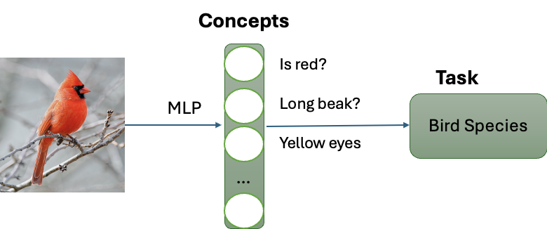
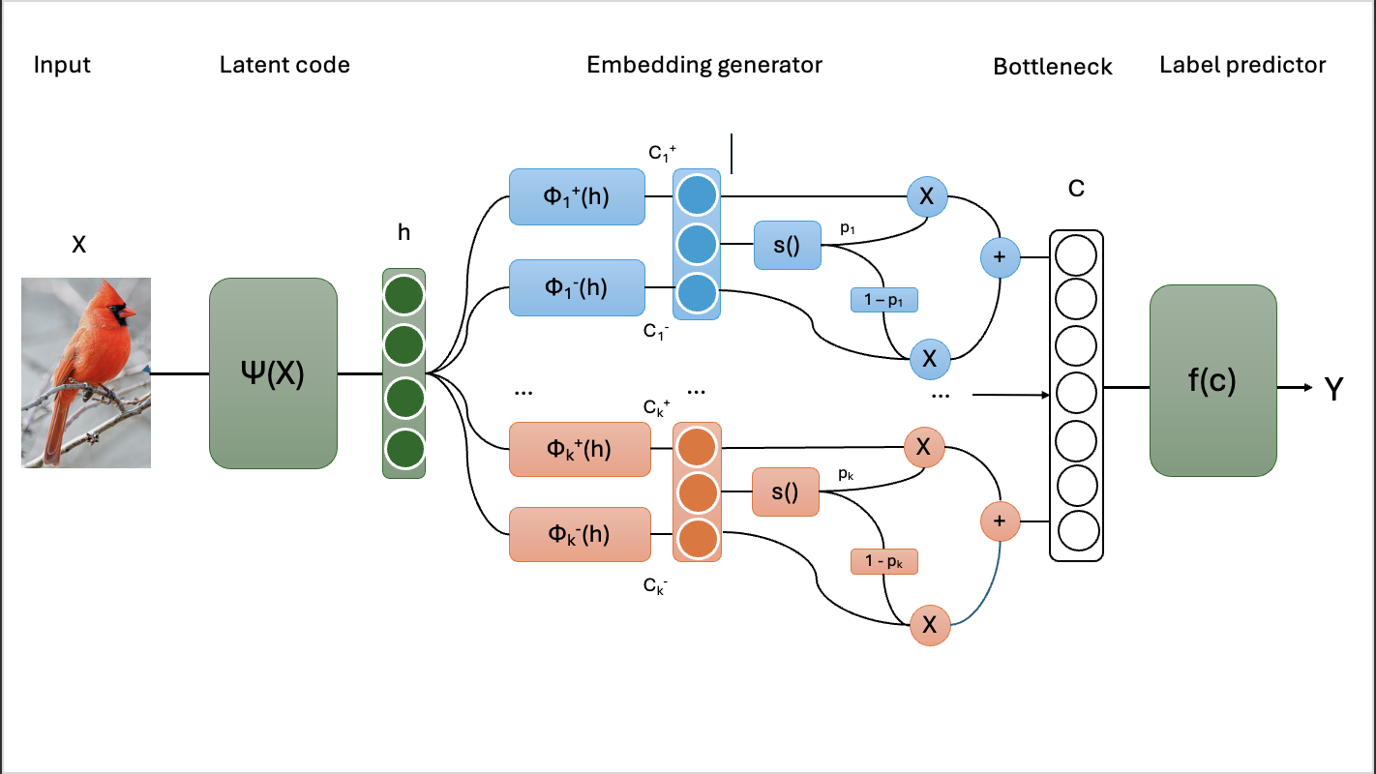
Two main paradigms
Concept Bottleneck Models
Concept Embedding Models
Architecture includes an intermediate layer of human-defined concepts.
Concept values​ are typically* treated as binary ground truth labels.
Training in 2 stages:
Predict concept values from input data.
Predict target label using only** those concept values
Notes:
At a certain point focus on explainable models rather than techniques, CBM emerged as premier architecture, CEM followed up in more recent times to try to address CBM limitations. (more on this in next slides)

Slide 6
Two main paradigms
Concept Embedding Models
Concept Bottleneck Models
Architecture includes an intermediate layer of human-defined concepts.
Concept values​ are typically treated as binary ground truth labels.
Training in 2 stages:
Predict concept values from input data.
Predict target label using only those concept values
Notes:
At a certain point focus on explainable models rather than techniques, CBM emerged as premier architecture, CEM followed up in more recent times to try to address CBM limitations. (more on this in next slides)

Slide 7
Drawbacks
Assumes all task-relevant information is captured by symbolic concept, very difficult to achieve irl, causing lower accuracy.
Especially problematic in domains like mental health: a single symptom is a risk indicator, not a diagnosis. Depression requires the presence of multiple symptoms, which behave differently.
Notes:
Example tiredness and changes in sleeping pattern, it’s two high prob but maybe then he just has hymnsomnia !

Slide 8
CEMs Key Innovation
Traditional CBMs use one number per concept, which may not capture enough nuances.
CEMs represent each concept with two full vectors: one for when the concept is active and one for when it's inactive.
This allows the model to reason more richly: not limited to how likely a concept is.

Slide 9
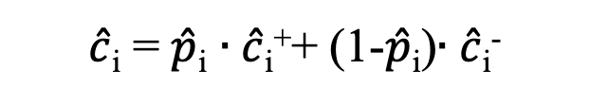
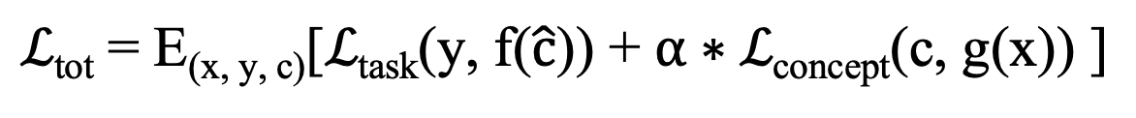

Comparison:
Training is done by minimizing the joint loss:
$$ℒ\text{tot} \text{= }\text{E}\text{(}\text{x}\text{, }\text{y}\text{, }\text{c}\text{)}\text{[}ℒ\text{task}\text{(}\text{y}\text{, }\text{f}\text{(}\hat{c}\text{)) }\text{+} α∗ℒ\text{concept}\text{(}\text{c}\text{, }\text{g}\text{(}\text{x}\text{)) ]}$$
CBMs
CEMs
$\hat{c}$_{i} = $\hat{p}$_{i}
$\hat{c}$_{i} = $\hat{p}$_{i} $∙\hat{c}$_{i}⁺+ (1-$\hat{p}$_{i})$∙\hat{c}$_{i}⁻

Slide 10

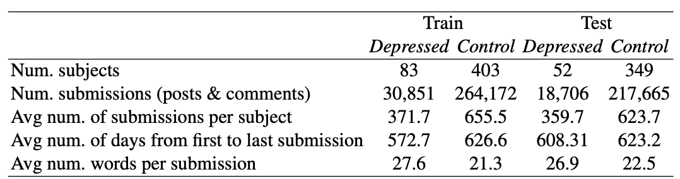
eRisk Dataset
Benchmark with multiple editions shared tasks.
Post history of reddit users, labelled positive when detecting alarming behavior.
Several challenges typical of this domain: Unbalanced minority class, uncertain labels, noise.

Slide 11

Depression
Gambling
Depression
Self-Harm
Gambling
Compulsive Gambling
Notes:
To test how these models do in the mental health field

Slide 12
Depression
Gambling
Depression
Self-Harm
Gambling
Compulsive Gambling
Notes:
Difficult but realistic settings for screening. Beside this challenges, this dataset offer several submissions to which compare our results!

Slide 13
Research questions
Are Concept-Based Models effective in mental healthcare settings despite the high level of label and textual noise?
Does incorporating concept-level explainability necessarily entail a performance trade-off compared to end-to-end black-box models?
Can a lightweight and easily deployable model achieve competitive performance for depression screening?

Slide 14
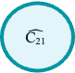
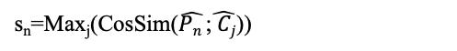
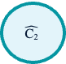
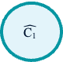
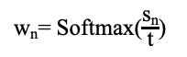
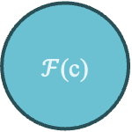
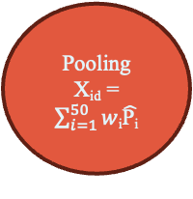
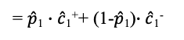
Pipeline
BDI-II 21 Symptoms (c)
UserID
Post (P)
Qwen
Concepts Probabilities
Post (P)
Concepts Ground Truth
Post (P)
SBERT
s_{n}=Max_{j}(CosSim($\hat{Pn }$;$\hat{ Cj}$))
Top-50 Posts
$$\hat{\text{C}\text{1}}$$
= $\hat{p}$₁ $∙\hat{c}$₁⁺+ (1-$\hat{p}$₁)$∙\hat{c}$₁⁻
w_{n}= Softmax($\frac{\text{s}\text{n}}{\text{t}}$)
Mental Condition (P/N)
Pooling
X_{id} = $\sum_{i=1}^{50}{w}$_{i}$\hat{\text{P}\text{i}}$
$$\hat{\text{C}\text{2}}$$
…
$ℱ$(c)
g(x)
Embedding_{id}
Embedding_{id}
Embedding_{id}
…
Size: 384
$$\hat{\text{C}\text{2}\text{1}}$$
…
Concepts: 21 Symptoms

Slide 15
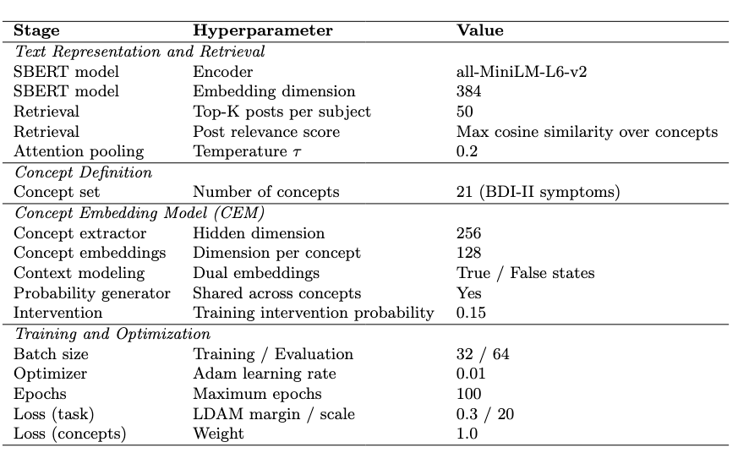
Hyperparameters:
Notes:
c+ and c- size in the baseline is hyp = 128.

Slide 16
Pipeline
BDI-II 21 Symptoms (c)
UserID
Post (P)
Qwen
Concepts Probabilities
Post (P)
Concepts Ground Truth
Post (P)
SBERT
s_{n}=Max_{j}(CosSim($\hat{Pn }$;$\hat{ Cj}$))
Top-50 Posts
$$\hat{\text{C}\text{1}}$$
= $\hat{p}$₁ $∙\hat{c}$₁⁺+ (1-$\hat{p}$₁)$∙\hat{c}$₁⁻
w_{n}= Softmax($\frac{\text{s}\text{n}}{\text{t}}$)
Mental Condition (P/N)
Pooling
X_{id} = $\sum_{i=1}^{50}{w}$_{i}$\hat{\text{P}\text{i}}$
$$\hat{\text{C}\text{2}}$$
…
$ℱ$(c)
g(x)
Embedding_{id}
Embedding_{id}
Embedding_{id}
…
Size: 384
$$\hat{\text{C}\text{2}\text{1}}$$
…
Concepts: 21 Symptoms

Slide 17
Concept Generation from BDI-II
1
Choose the concept from diagnostic manual: BDI –II questionnaires symptoms in our case.
2
Use an LLM (Qwen2.5-72b) to produce scores for each user for each concept.
Notes:
Choosing the concepts for this models is usally quite difficult, but not for us! This is a short and sound method already used in literature…
Why not LLM for all? While LLM can produce some explanations, they are not intrinsic of their decision process, and they have other problems as well: they are computationally expensive, against our requirement of a screening tool easy to deploy, they hallucinate

Slide 18
Pipeline
BDI-II 21 Symptoms (c)
UserID
Post (P)
Qwen
Concepts Probabilities
Post (P)
Concepts Ground Truth
Post (P)
SBERT
s_{n}=Max_{j}(CosSim($\hat{Pn }$;$\hat{ Cj}$))
Top-50 Posts
$$\hat{\text{C}\text{1}}$$
= $\hat{p}$₁ $∙\hat{c}$₁⁺+ (1-$\hat{p}$₁)$∙\hat{c}$₁⁻
w_{n}= Softmax($\frac{\text{s}\text{n}}{\text{t}}$)
Mental Condition (P/N)
Pooling
X_{id} = $\sum_{i=1}^{50}{w}$_{i}$\hat{\text{P}\text{i}}$
$$\hat{\text{C}\text{2}}$$
…
$ℱ$(c)
g(x)
Embedding_{id}
Embedding_{id}
Embedding_{id}
…
Size: 384
$$\hat{\text{C}\text{2}\text{1}}$$
…
Concepts: 21 Symptoms

Slide 19

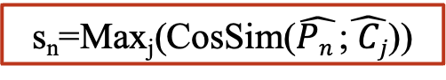
Retrieval
Some users have a lot of posts about eterogenous topics, which diluite possible signals, so we need to retrieve a set number of relevant ones.
Key Idea: Compute Cosine Similarity between embeddings of posts and embedding of each concepts, SBERT (all-MiniLM-L6-v2) is perfect for this.
We rank them using the sum of the similarity of every concept!
We rank them using the max w.r.t. every concept!
s_{n}=Max_{j}(CosSim($\hat{Pn }$;$\hat{ Cj}$))
Notes:
Sbert and not clinical bert because sbert is trained in sentence comparison. I’ve tried several different ways and max is by far the best one, more about it the next slide

Slide 20
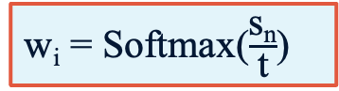
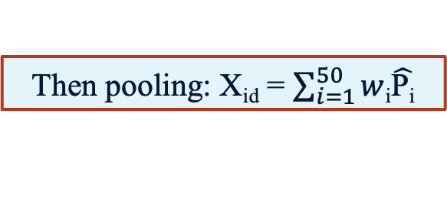
Pooling
Multi Instance Learning (M.I.L) labels are provided at bag (user) level, not post, so we need to pool to one vector per user now.
Posts have different importance, that we already computed a metric for that and can use again.
w_{i} = Softmax($\frac{\text{s}\text{n}}{\text{t}}$)
Then pooling: X_{id} = $\sum_{i=1}^{50}{w}$_{i}$\hat{\text{P}\text{i}}$
Notes:
Max based retrieval perform much better!
That’s more important that it seems From psychology we’d be led to think that one need to show sign across time but it’s too much noise, so catching alarming signals is more efficient.

Slide 21
Example:
’’Awesome as always!”
“Nice cat”
“Long post about ex-girlfriend”
… tot 229 posts
Retrieval
Post | MAX Similarity Score | Best Matching Concept
… I am just contemplating my worthlessness | 0.5567 | Worthlessness
… what makes it hard is that having insomnia basically gives you a lot of the symptoms for other conditions. Feeling tired, depressed, etc. | 0.5270 | Changes in sleeping pattern
…
Pooling
Notes:
Sbert and not clinical bert because sbert is trained in sentence comparison. I’ve tried several different ways and max is by far the best one, more about it the next slide

Slide 22
Pipeline
BDI-II 21 Symptoms (c)
UserID
Post (P)
Qwen
Concepts Probabilities
Post (P)
Concepts Ground Truth
Post (P)
SBERT
s_{n}=Max_{j}(CosSim($\hat{Pn }$;$\hat{ Cj}$))
Top-50 Posts
$$\hat{\text{C}\text{1}}$$
= $\hat{p}$₁ $∙\hat{c}$₁⁺+ (1-$\hat{p}$₁)$∙\hat{c}$₁⁻
w_{n}= Softmax($\frac{\text{s}\text{n}}{\text{t}}$)
Mental Condition (P/N)
Pooling
X_{id} = $\sum_{i=1}^{50}{w}$_{i}$\hat{\text{P}\text{i}}$
$$\hat{\text{C}\text{2}}$$
…
$ℱ$(c)
g(x)
Embedding_{id}
Embedding_{id}
Embedding_{id}
…
Size: 384
$$\hat{\text{C}\text{2}\text{1}}$$
…
Concepts: 21 Symptoms
Notes:
And the light blue part? I’ve already explained the core principle, so here’s a quick example of how it works.

Slide 23
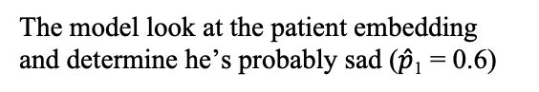
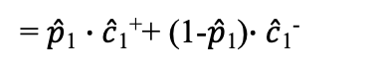
Example:
Let’s take only the first concept, sadness.
c₁ = 0.6⋅[1.2, 0.5, …]+0.4⋅[0. 1,−0. 4, …] =[0.76, 0.14, …]
VS
Assuming some learned embeddings for the concept of sadness : c₁+ = [1.2, 0.5, …]; c₁− = [0.1, −0.4, …]
CBM only passing 0.6
The model look at the patient embedding and determine he’s probably sad ($\hat{p}$₁ = 0.6)
$$\hat{\text{C}\text{1}}$$
= $\hat{p}$₁ $∙\hat{c}$₁⁺+ (1-$\hat{p}$₁)$∙\hat{c}$₁⁻
$$\hat{\text{C}\text{2}}$$
…
$ℱ$(c)
g(x)
Embedding_{id}
Embedding_{id}
Embedding_{id}
…
Size: 384
$$\hat{\text{C}\text{2}\text{1}}$$
…
Concepts: 21 Symptoms

Slide 24
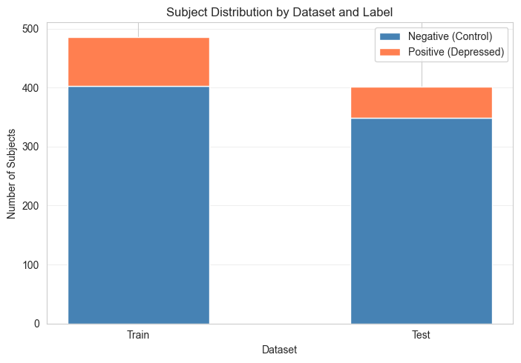
Class Unbalance
17%
LDAM Loss
Threshold optimization
Specific metrics
13%
Notes:
Quick mention

Slide 25
Pipeline
BDI-II 21 Symptoms (c)
UserID
Post (P)
Qwen
Concepts Probabilities
Post (P)
Concepts Ground Truth
Post (P)
SBERT
s_{n}=Max_{j}(CosSim($\hat{Pn }$;$\hat{ Cj}$))
Top-50 Posts
$$\hat{\text{C}\text{1}}$$
= $\hat{p}$₁ $∙\hat{c}$₁⁺+ (1-$\hat{p}$₁)$∙\hat{c}$₁⁻
w_{n}= Softmax($\frac{\text{s}\text{n}}{\text{t}}$)
Mental Condition (P/N)
Pooling
X_{id} = $\sum_{i=1}^{50}{w}$_{i}$\hat{\text{P}\text{i}}$
$$\hat{\text{C}\text{2}}$$
…
$ℱ$(c)
g(x)
Embedding_{id}
Embedding_{id}
Embedding_{id}
…
Size: 384
$$\hat{\text{C}\text{2}\text{1}}$$
…
Concepts: 21 Symptoms

Slide 26
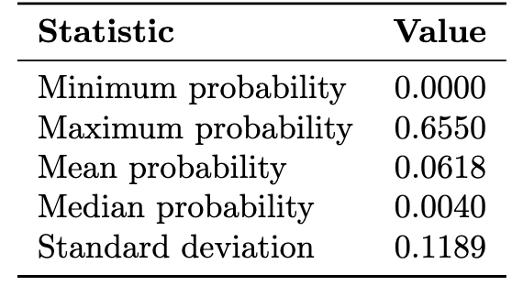
Performance on concepts
Very unbalanced! This means that accuracy metrics would not be indicative as setting an approppriate threshold for every concept is not of interest to us, these are continuos signals anyway and not really classification.
Looking at the distribution it seems the model tends to be cautious with the probabilities, it might be better to scale [0, MAX] to [0, 100] for reporting.
Notes:
50 posts per user to try catch different symptoms but could experiment with lower for better task prediction.
Unbalanced activations! This means that accuracy metrics would be not very indicative as these are continuos signals anyway and not really classification.
Also it might be worth scaling [0, 65] to [0,100] for easier communication with the patient.

Slide 27
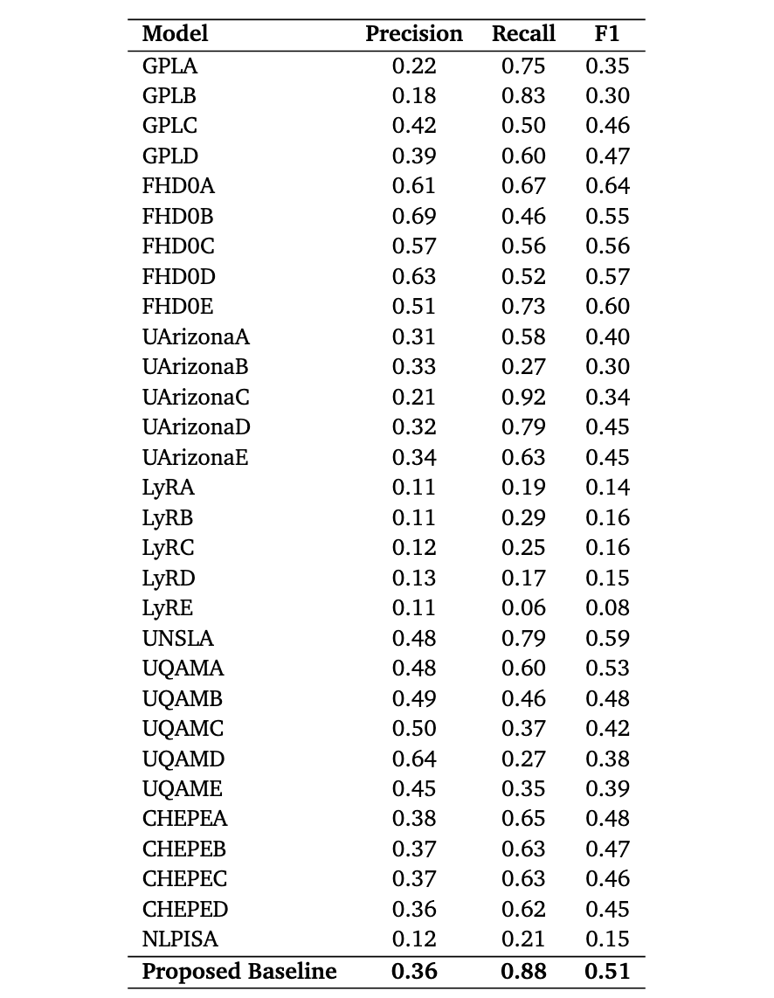



Performance on Task
ROC-AUC: 0.88
Accuracy: 0.78
Recall (binary): 0.88
Precision (binary): 0.36
F1 (binary): 0.51
MCC: 0.47
While:
Keeping a lightweight model
Providing explanability
Not using fine-tuning/ complete hyperparameter optimization
Notes:
Metrics here are binary!
No optuna notebook because even with asha pruner etc it takes a lot and a lot of computing resources, and if I had to do it for one experiment, then to check what was doing better I
Winner is saint luis, runner up dortmund

Slide 28


Notable Variants
CBMs
Catching Extremes
Scaled up
Performance severely sub-optimal with respect to best performing models of the challenge, and CEMs:
(0.59 AUC-ROC)
Beyond a certain threshold, temperature scaling has negative impact on performance.
Adding the data from another edition to training, wider layers, 768 embedding size: Some small improvements,
(0.89 AUC-ROC).

Slide 29
Key findings
1
Concept Bottleneck Models were found to struggle in this application domain.
Concept Embedding Models emerged as a substantially more robust alternative when combined with techniques that mitigate the key challenges of the field.
2
3
Pooling strategies have a strong impact on final result, focus on catching extremes with Max is to be preferred

Slide 30
Limitations
Labelling of both the users and the concepts was not done by experts, but rather by a tested strategy.
1
2
This work set aside the temporal aspects of eRisk benchmark to focus on interpretability.

Slide 31
Future work
1
This pipeline can be applied to different mental illnesses with minimal effort.
2
Trying other datasets/benchmarks, possibly involving domain experts contributions.
3
Trying more complex retrieval and pooling strategies, bigger model, complete hyperparameter tuning to push performance.
Notes:
Depression in eRisk seems to be the one with worst performances.

Slide 32
Thanks for your attention!

Slide 33
Intervention
Replaces predicted concept values with ground truth or desired values, which then propagates to affect final predictions.
In our setup concept intervention is automatic and stochastic, a fixed percentage of concept probabilities is replaced with ground truth during training, enforcing supervision as a regularization signal rather than a deliberate correction.
They allow you to test whether the model actually uses concepts causally or only correlationally. If changing a concept embedding predictably changes the output, this is evidence that the concept lies on the decision path.
Recent Intervention-aware Concept Embedding Models learn end-to-end intervention policies that significantly outperform standard models, however they showed noimprovements in this code. Very recent pubblications have shown that they might suffer in noisy context, and newer models were proposed to alleviate this.

Slide 34
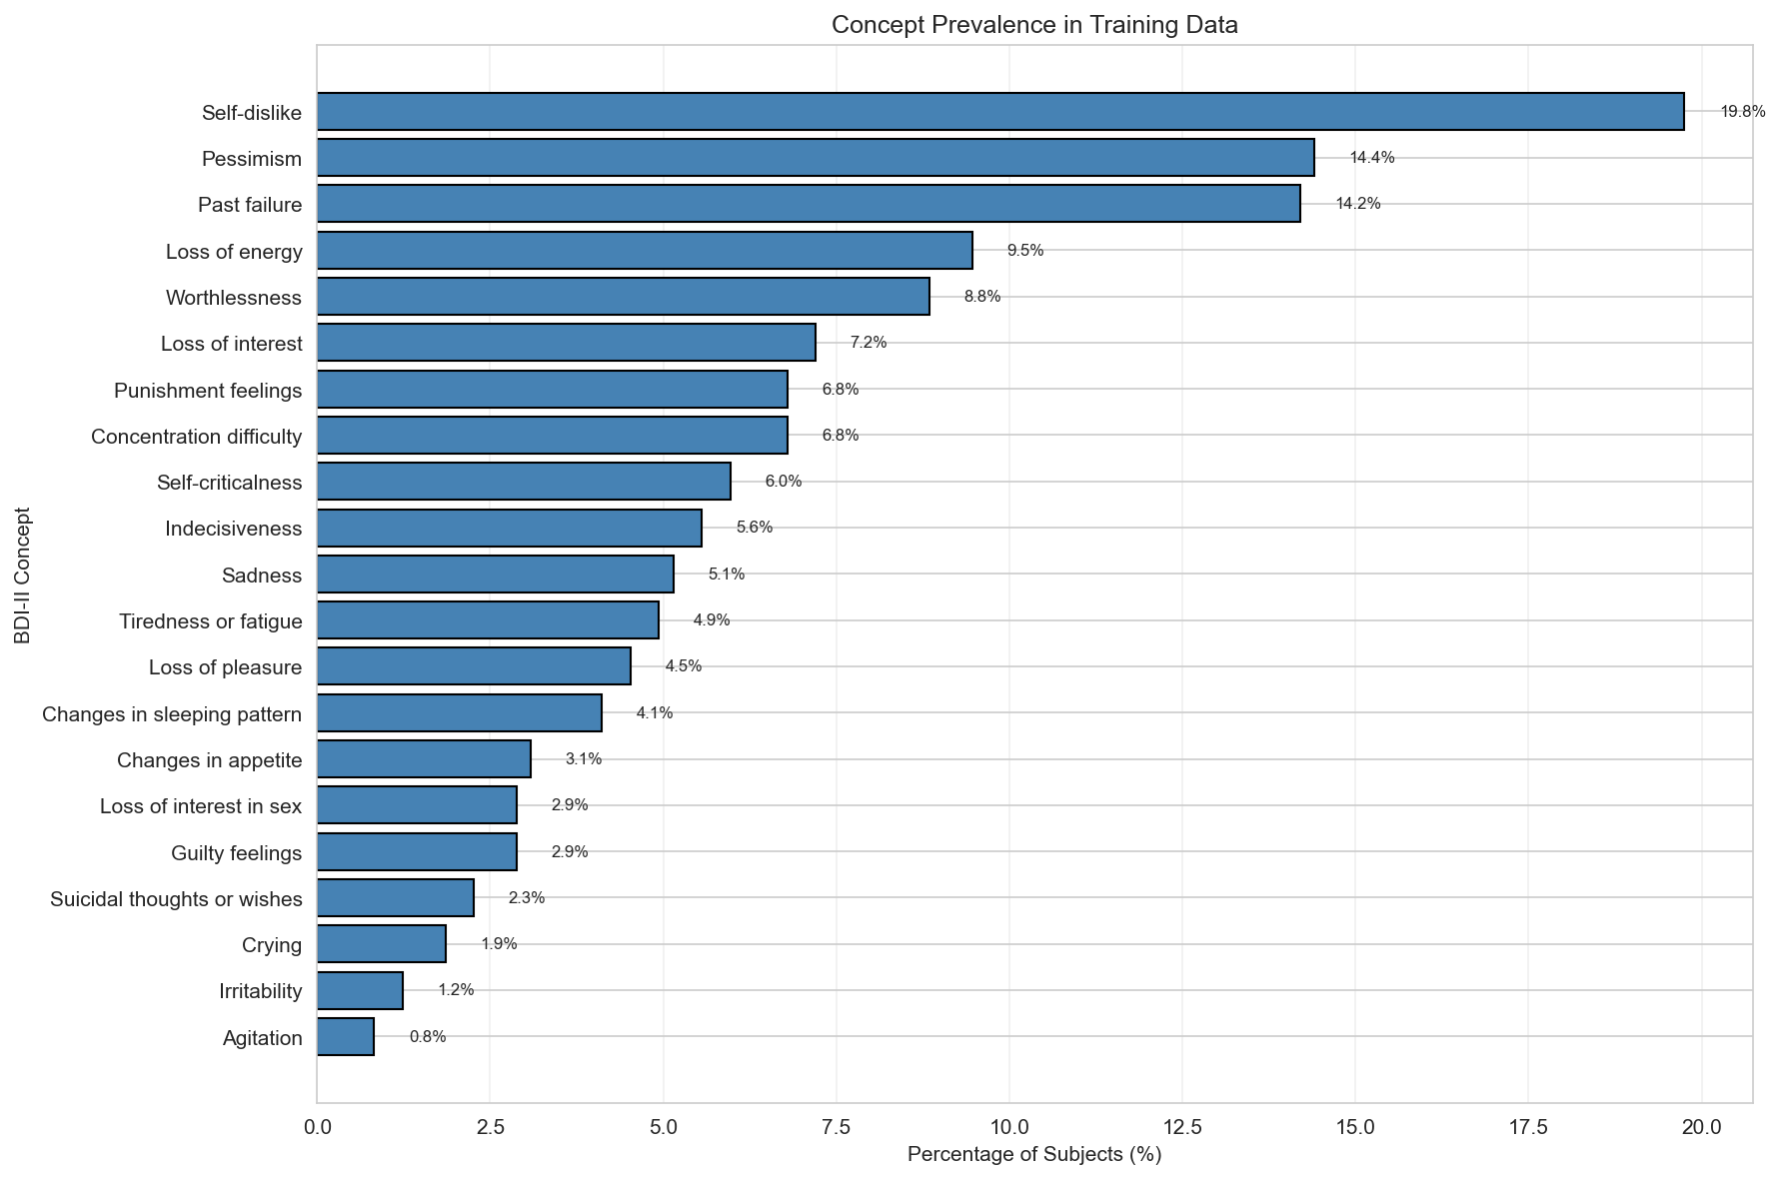

Slide 35
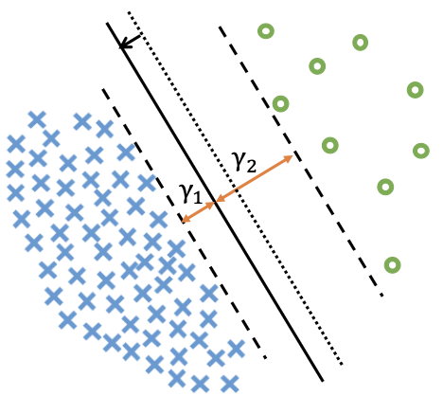
LDAM

Slide 36
Example:
1 Worthlessness 0.2530
2 Past failure 0.2521
3 Self-dislike 0.2493
4 Loss of energy 0.2025
5 Pessimism 0.1847
6 Loss of interest 0.1618
7 Sadness 0.1580
8 Punishment feelings 0.1492
9 Changes in sleeping pattern 0.1448
10 Concentration difficulty 0.1295
Embedding_{id}
Embedding_{id}
FFNN
Embedding_{id}
Size: 384
Notes:
c+ and c- size in the baseline is hyp = 128.

